Slide 1

CAPSTONE PROJECT
ŞEYMA NUR AKSOY

Slide 2

Contents
Ş
My Story
Core Skills
Hard Skills & My Project

Slide 3

My Story

Slide 4
Core Skills

Slide 5

FeedForward
Communication
Self Respect
Sharing
Self Confident
Motivation
Improve This Skill
My Core Skills
My Groups Core Skills

Slide 6
Hard Skills and My Project

Slide 7
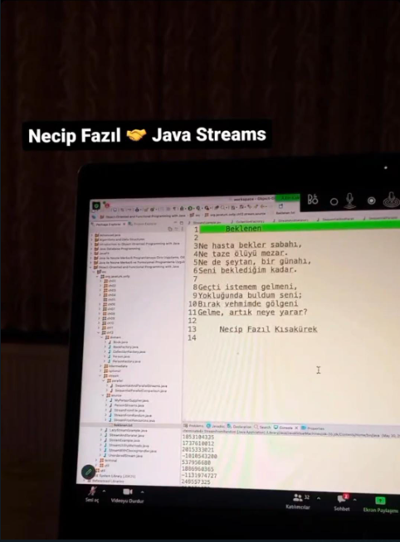

Slide 8
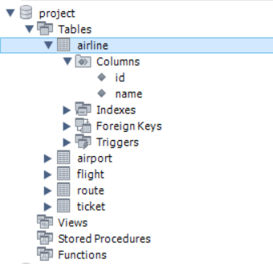
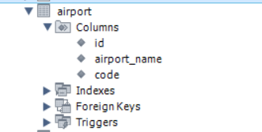
MYSQL DATABASE

Slide 9
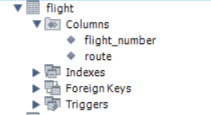
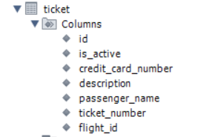
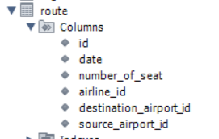

Slide 10
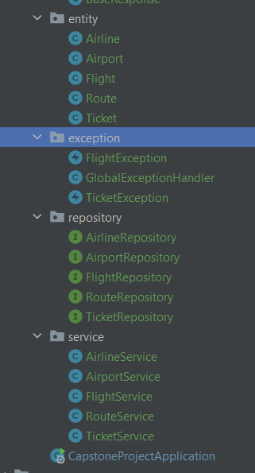
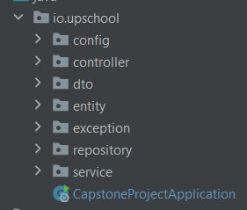
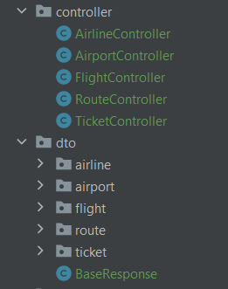
PROJECT STRUCTURE

Slide 11
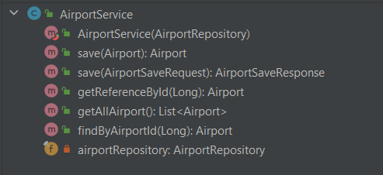
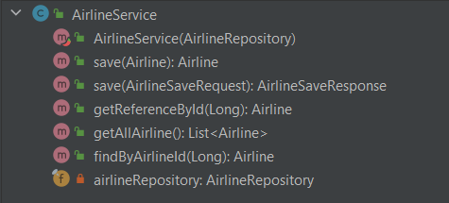

Slide 12
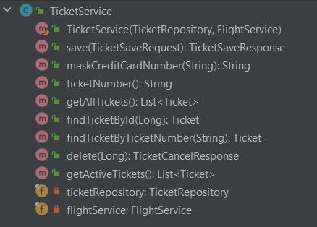
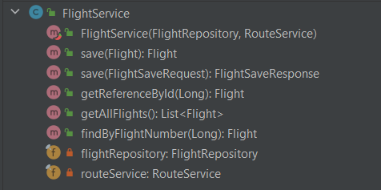
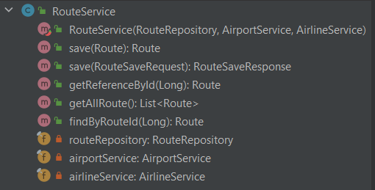


Slide 13

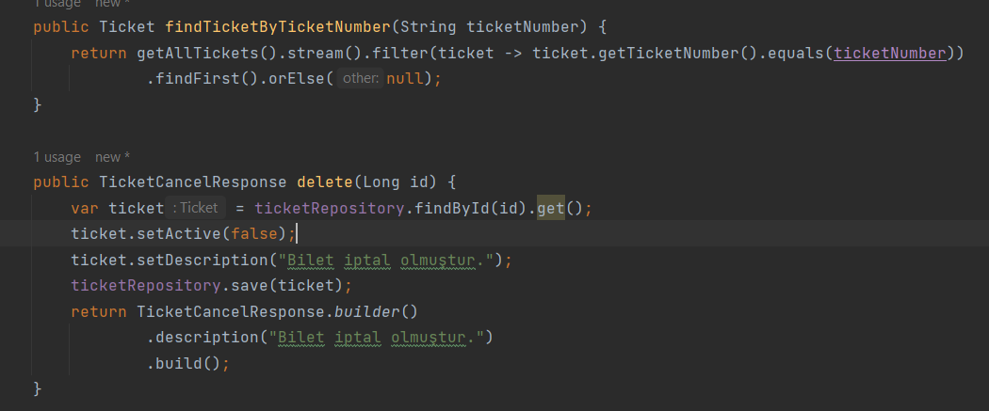

Slide 14
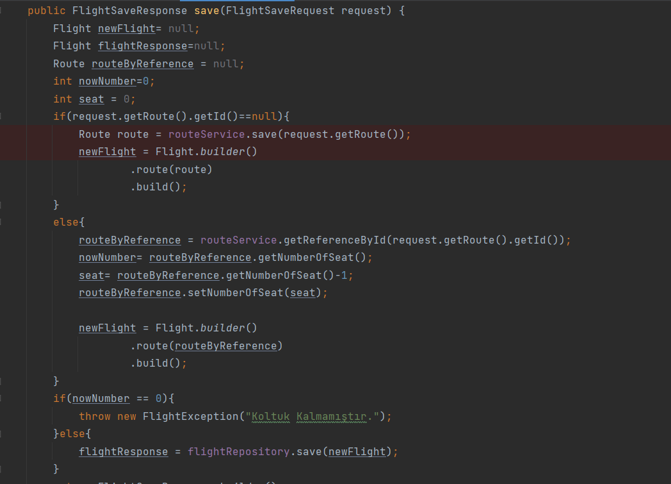

Slide 15
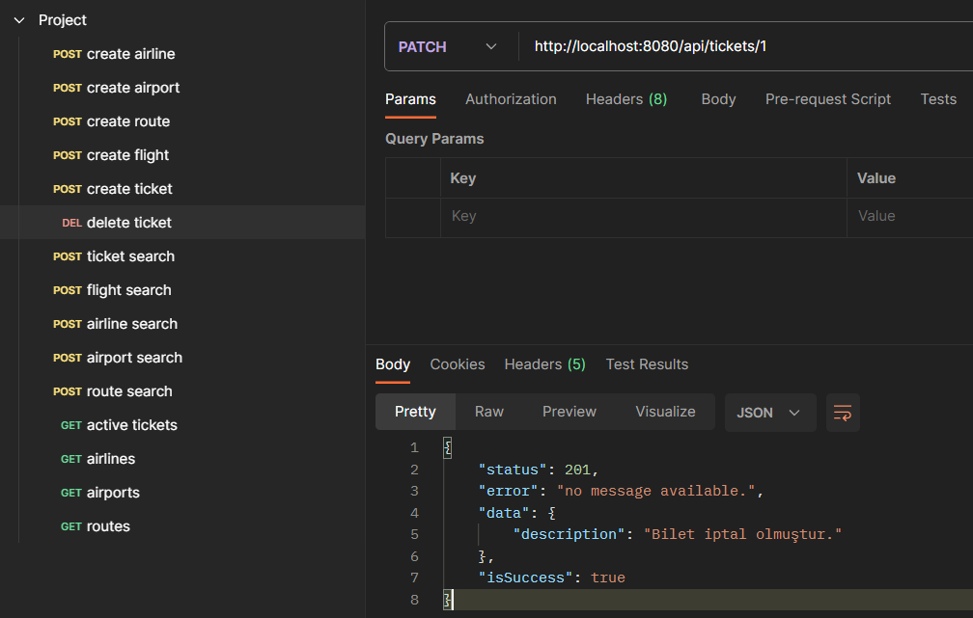

Slide 16
Thank you ☺
Şeyma Nur Aksoy
aksoyseyma192@gmail.com

